Slide 1
Mr. Rodenburg’s Classroom
Chemistry/Mathematics
Room 3211
Gila Ridge High School
August 19, 2013

Slide 2
Overview
About the teacher
About the curriculum
About the class
Strategies for success

Slide 3
About the Teacher
John Rodenburg
  (Mr. Rodenburg to students)
Grew up in suburban Chicago
Graduated from United States Naval Academy in Annapolis, MD
Served as a Logistics Officer in the United States Marine Corps
Licensed Realtor with Century 21 Action Group
Currently working on two Master’s degrees:
  Secondary Education at U of A
  Educational Administration and Supervision at ASU
Certified in the following high school content areas:
  Chemistry
  Mathematics
  Biology
  Geography
  History
  English
  Art
Sponsor/Coach of:
  Math Club
  Photography Club
  Class of 2015
  2014 Senior Powder Puff team

Slide 4
About the Curriculum
Yuma Union High School District has adopted curriculum from the University of Cambridge, particularly the IGCSE curriculum materials.
IGCSE stands for International General Certificate of Secondary Education, and refers to curriculum that is designed for secondary students between the ages of 14 and 16.
Inquiry-based instruction.

Slide 5
About the Class (Chemistry)
Lab Safety is paramount.
Personal responsibility is a must.
Grades will consist of the following:
  60% Assessments
  25% Labs and in-class projects
  15% Homework
Semester Grades are calculated as follows:
  Grading Period 1: 30%
  Grading Period 2: 30%
  Grading Period 3: 25%
  Final Exam: 15%
There is no textbook.
Online access at school is required.
Binder and notebook paper are required.

Slide 6
About the Class (Mathematics)
Spiraling and inquiry-based learning.
The Common Core State Standards.
Grades will consist of the following:
  60% Assessments
  30% Homework and classwork
  10% Participation
Semester Grades are calculated as follows:
  Grading Period 1: 30%
  Grading Period 2: 30%
  Grading Period 3: 25%
  Final Exam: 15%
There is no textbook.
Binder and notebook paper are required.

Slide 7
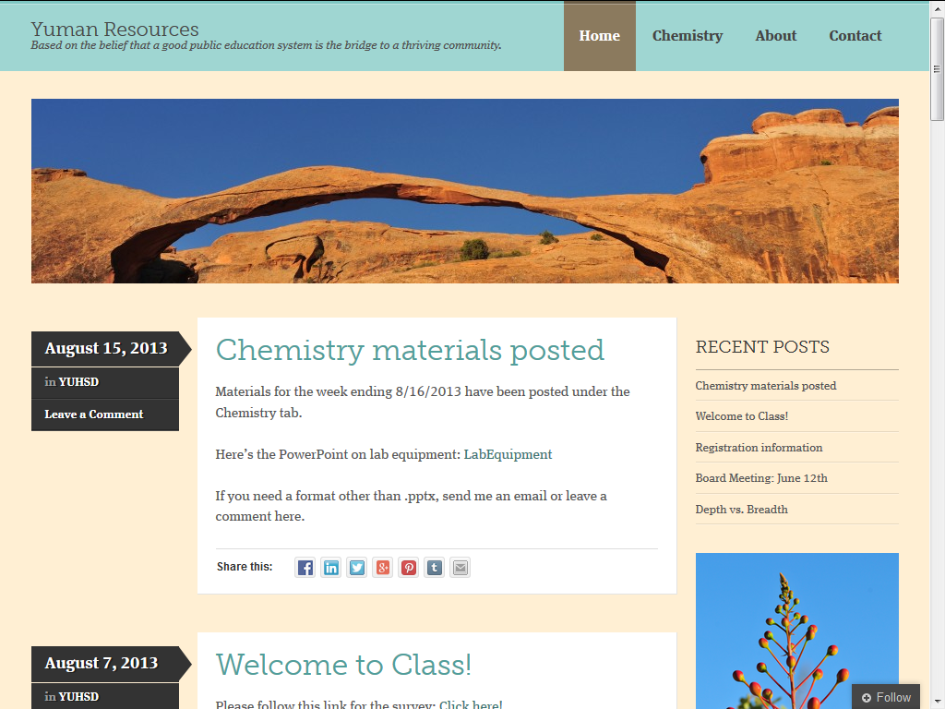
Strategies for Success
Personal Responsibility
  Late work
  Absences
  Test corrections
  Extra help
Communication
  E-mail: jrodenburg@yumaunion.org
  Cell: (928) 289-9862 (call or text is fine)
  Website: www.YumanResources.com
  Twitter: @mr_rodenburg
  Facebook: www.facebook.com/Mr.Rodenburg
  Linkedin: Link on website

Slide 8
Strategies for Success
Personal Responsibility
  Late work
  Absences
  Test corrections
  Extra help
  StudentVUE
Communication
  E-mail: jrodenburg@yumaunion.org
  Cell: (928) 289-9862 (call or text is fine)
  Website: www.YumanResources.com
  Twitter: @mr_rodenburg
  Facebook: www.facebook.com/Mr.Rodenburg
  Linkedin: Link on website

