Slide 1
Unit 1: Experimental techniques
Measurements
Chromatography and Chromatograms
Purity
Purification and Separation

Slide 2
Proper measurements
Things we need to measure:
Time Temperature Length Mass Volume
What do we measure them with and in what units?
Time is measured on a stopwatch and is always measured in seconds (s).
Temperature is measured with a thermometer and is always measured in degrees Celsius (°C).
Length is measured with a ruler in either centimeters (cm) or millimeters (mm).
Mass is measured on a scale and is measured in grams (g).
Volume is measured with a graduated cylinder for less precise measures and is in milliliters (mL).
  Ex: Measure 25 mL of H₂O. (No decimal place)
Volume is also measured with a burette or a pipette for more precise measures an is in milliliters (mL).
Ex: Measure 25.7 mL of HCl. (One decimal place)

Slide 3

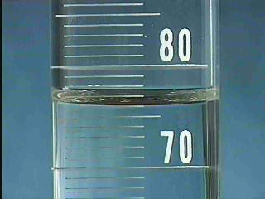
Burette or Pipette
Proper decimal place by piece of equipment
Graduated cylinder
21.15 ml
76.0 mL

Slide 4
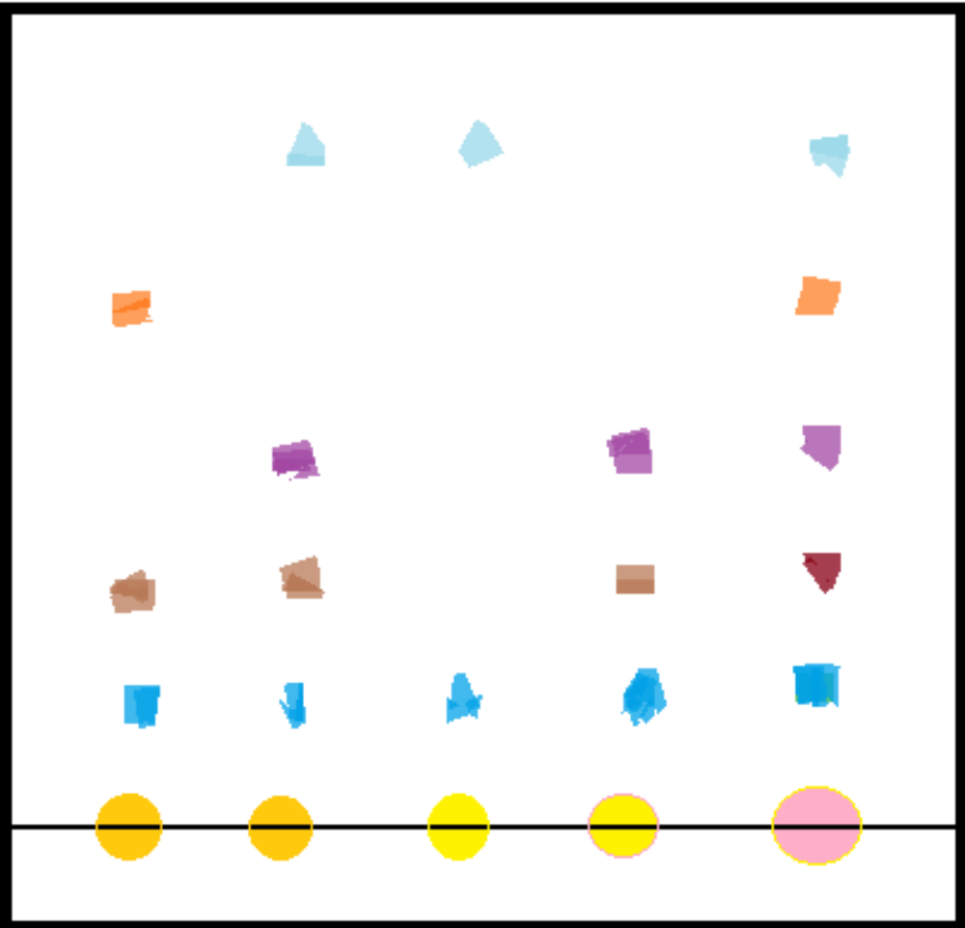
Chromatography
Paper Chromatography
Obtain piece of chromatography paper
Draw a line in pencil on bottom of paper
Place dots of sample on line
Insert paper into a jar with a small layer of solvent
When solvent rises it allows sample to moved based on its polarity
Light Blue = Cocaine
Orange = Heroin
Purple = Methamphetamine
Grey = MDMA
Dark Blue = THC
1 2 3 4 Control

Slide 5
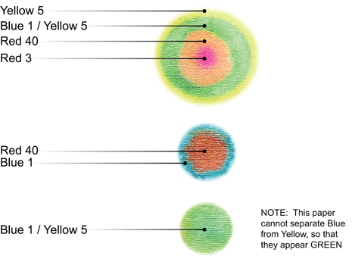
Radial Chromatogram

Slide 6
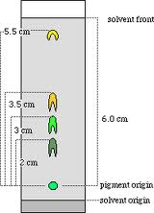
Chromatograms and R_{f} values
Chromatograms are the paper display of the separation of different substances within a mixture.
Used for drug screens, inks, sweets, leaves, dyes and food colourings.
R_{f} is the rate of flow of the mobile phase (the sample) across the stationary phase (the paper).
R_{f} = distance travelled by compound
-----------------------------------------------------
distance travelled by solvent
R_{f} of yellow = 3.5 cm / 6.0 cm
= 0.583

Slide 7
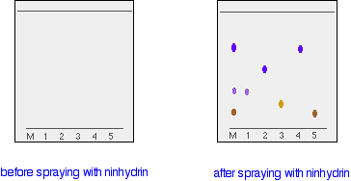
Colourless chromatography
Before spraying with ninhydrin After spraying with ninhydrin
Ninhydrin is called a locating agent

Slide 8
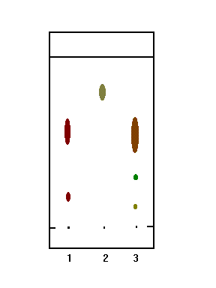
Pure vs. impure substances
Pure substances are made of one component.
Impure substances are made of multiple substances.
Which substances are pure and which are impure?
How can you tell?
Impure substances can be identified by a change in melting or boiling point.
Ex:
  MP of Sn = 231.9 °C
  MP of Pb = 327.5 °C
  MP of solder = 188 °C
Why might this be important?

Slide 9
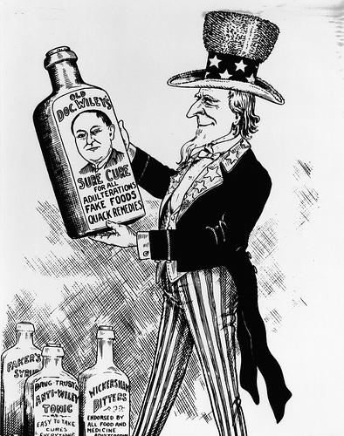
Purity in life
Coca-Cola
  In 1903 purity was called in to question on amount of cocaine and then later caffeine in Coca-Cola.
Medical Drugs
  Anything with alcohol, cocaine, heroin, morphine or cannabis must have accurate purity on each dose.
Regulations also exist on cosmetics, insecticides and fertilizers, as well as many foods and drugs consumed regularly.

Slide 10
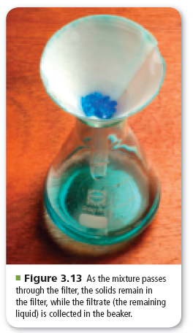
Filtration
Used to separate heterogeneous mixtures composed of solids and liquids
Uses a porous barrier to separate the solid from the liquid
Liquid passes through leaving the solid in the filter paper

Slide 11
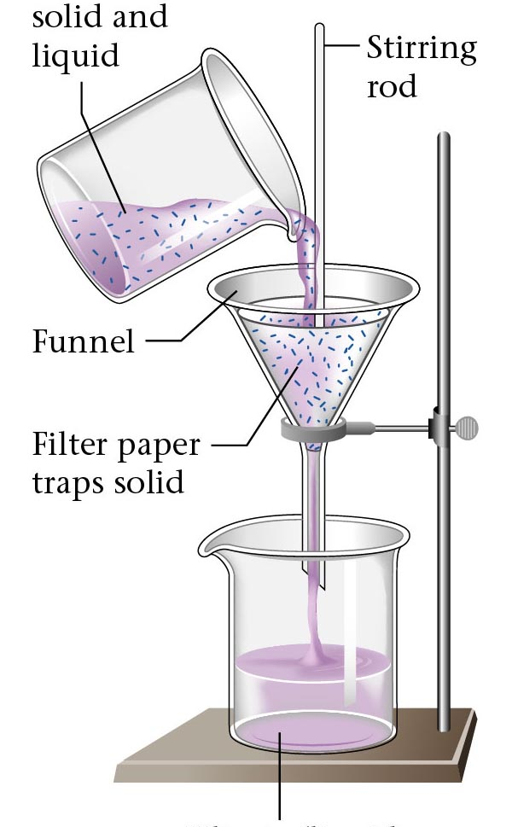
What could be filtered this way?
Sugar and Salt
Sandy water
Raisin Bran

Slide 12
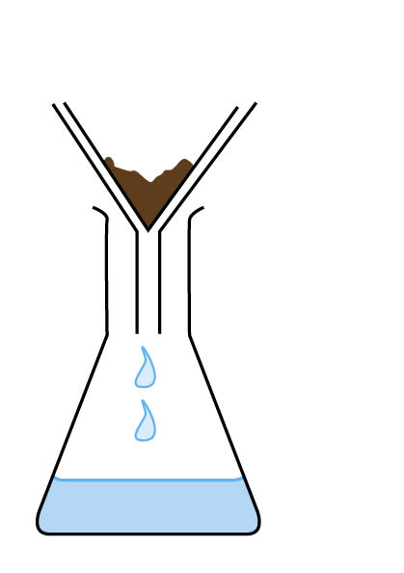
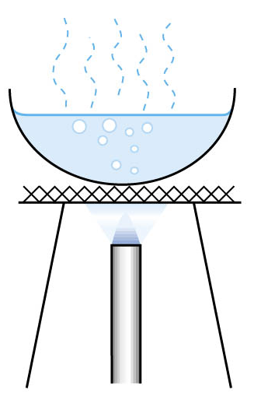
Crystallization after Filtration
1. Pour some distilled water into the mixture to dissolve the soluble substance.
2. Filter the mixture.
3. Wash the residue with a little distilled water to remove all the salt solution from it. The residue is sand.
4. Evaporate the filtrate to dryness. Salt is recovered.

Slide 13
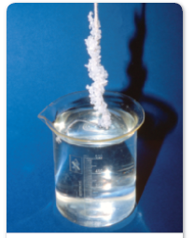
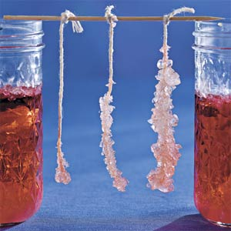
Crystallization
Separation technique that results in the formation of pure solid particles from a solution containing the dissolved substance
As one substance evaporates, the dissolved substance comes out of solution and collects as crystals
Produces highly pure solids
Rocky candy is an example of this

Slide 14
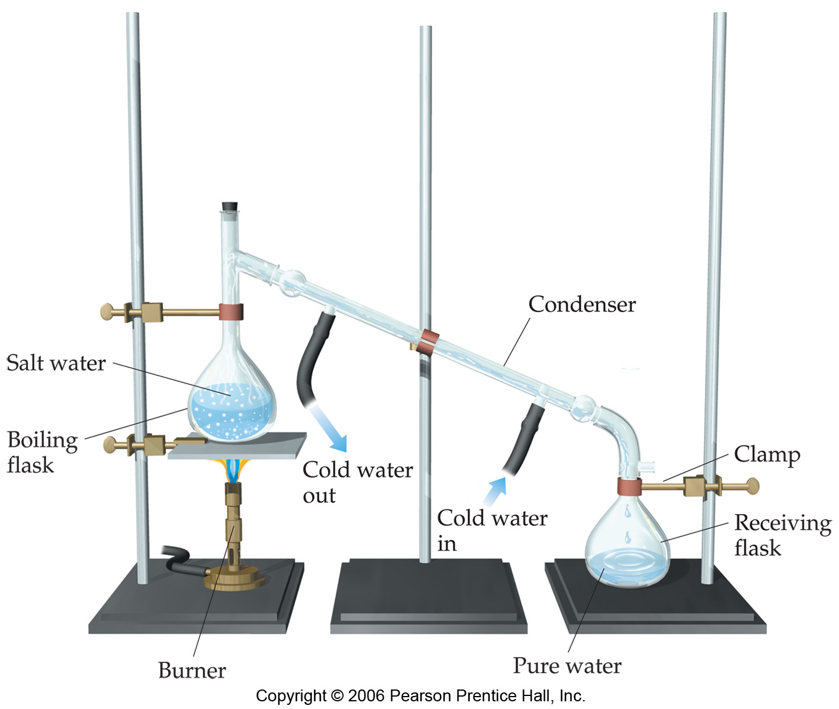
Distillation
Separates homogeneous mixture on the basis of differences in boiling point.

Slide 15
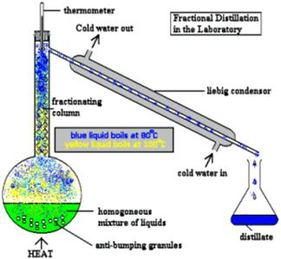
Fractional distillation
This is the technique used to separate a mixture of two miscible liquids with different boiling points.
Ex: water and ethanol
The boiling point for water is 100 while for ethanol it is 78.

Slide 16
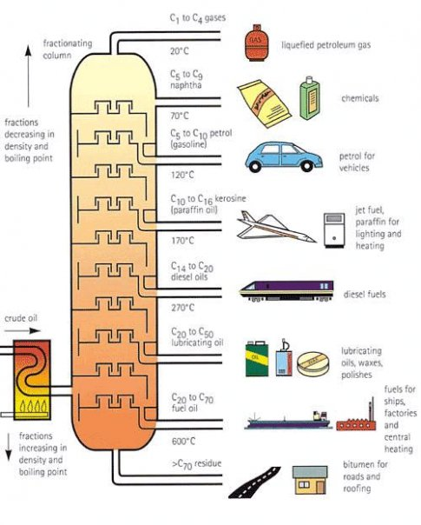
Fractional Distillation

