Slide 1
Ionic Bonding

Slide 2
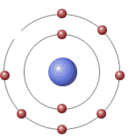
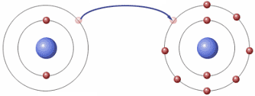
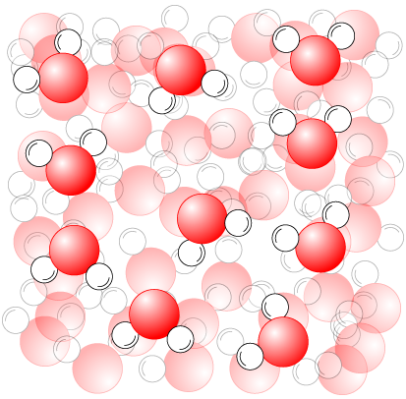
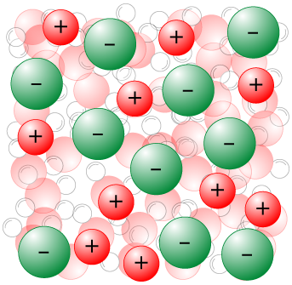
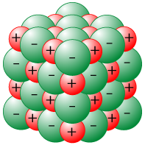
1. Ionic bonding
Made from reaction of metals with non-metals.
Electron
donation
Li
F
Li⁺
F⁻
Attraction
Positive metal ions and negative non-metal ions attract each other strongly to make potentially infinitely large continuous and uniform structures.
+
Ions in uniform structure
Water
Ions moving freely in solution

Slide 3
An aluminium atom has the electron structure 2,8,3. It needs to lose 3 electrons to become stable.

Slide 4
How many electrons does oxygen need to gain or lose to become stable?
An oxygen atom has the electron structure 2,6. It needs to gain 2 electrons in its outer shell to become stable.

Slide 5
Draw diagrams to show the ions that would be formed from the following atoms
Aluminium
Potassium
Fluorine
Oxygen
Lithium
Copper
Magnesium

Slide 6
Beryllium fluoride - BeF₂
Each beryllium atom need to lose two electrons, but each fluorine only needs 1
2+
F
Be
F

Slide 7
1. Characteristics of Ionic Bonds
High melting points
Hard but brittle
Uniform, repeat structure (alternating + and – ions)
Unreactive when solid (especially “ordinary” ionic compounds, e.g. NaCl, MgO)
Dissolve in water to create solutions
Do not conduct electricity when solid, but do in solution or when molten

Slide 8
Try and draw diagrams to show how the following combinations would bond together
Lithium and chlorine
Calcium and oxygen
Aluminium and chlorine
Potassium and bromine
Magnesium and fluorine
Magnesium and oxygen
Beryllium and oxygen
Calcium and chlorine

Slide 9
Covalent Bonding

Slide 10
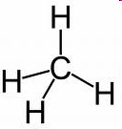
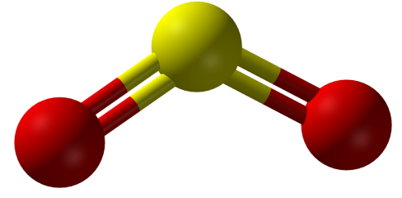
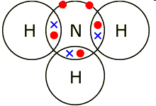
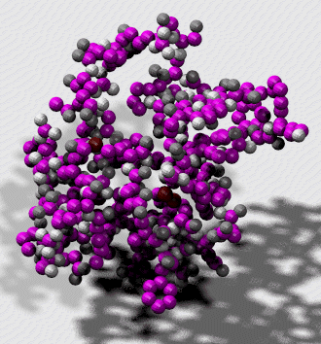
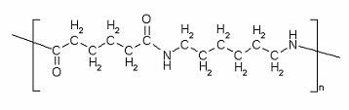
2. Simple covalent bonding
Normally small molecules made from non-metals bonded to non-metals
Methane, CH₄
Ammonia, NH₃
Sulfur dioxide, SO₂
But it also applies to relatively large molecules, like proteins and polymers
Nylon
Small protein molecule

Slide 11
2. Simple covalent bonding
Covalently bonded compounds are small and use covalent bonds (share electrons).
Low melting points
Solids, liquids or gases at room temperature
Small, finite structures (although polymers are finite but very long)
Can be very reactive due to size and combination of non-metals
Normally soft and brittle when solid
Volatile (e.g. iodine, I₂, evaporates from solid to gas easily at room temperature)

Slide 12
Giant Covalent Bonding

Slide 13
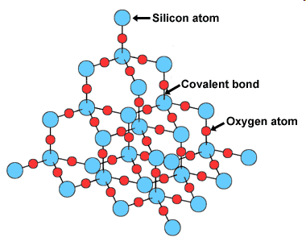
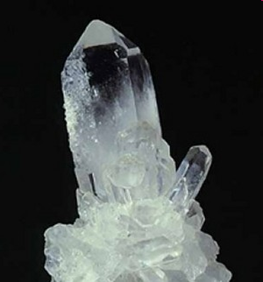
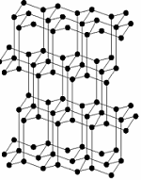
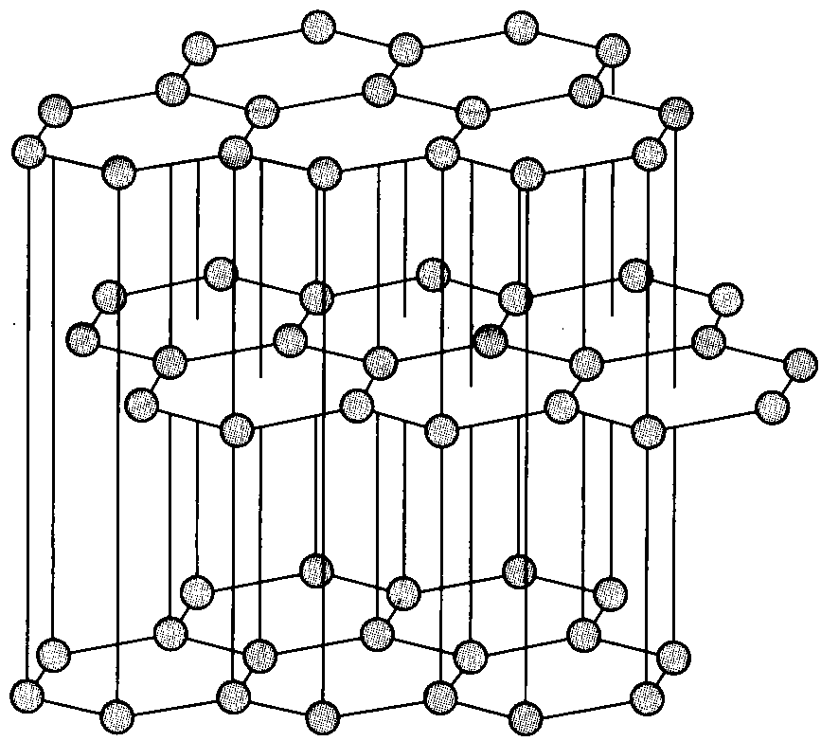
3. Giant covalent
Like in ionic structures, bonding can go on infinitely between the atoms, but covalent bonds are the rule here (as non-metals only are involved).
SiO₂, silicon dioxide. Also known as silica, quartz or sand
Allotropes of carbon. Two different giant covalent structures
Diamond
Graphite

Slide 14
3. Giant covalent
Giant covalent compounds’ characteristics are mostly due to a highly uniform structure with very strong covalent bonds.
Extremely high melting points
Extremely hard (more than ionics) but brittle
Uniform, covalently bonded repeat structure
Unreactive when solid, because of many strong bonds holding atoms in place
Normally do not conduct electricity (exceptions: graphite and silicon)
Do not dissolve in water

Slide 15
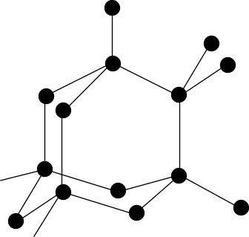
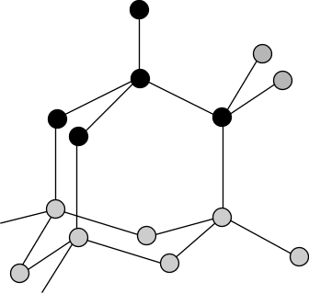
More on carbon: diamond
Very high melting point
Many covalent bonds must be broken to separate the atoms
Very strong
Each C atom is joined to four others in a rigid structure
Non-conductor of electricity
No free electrons - all C electrons are used for bonding
Tetrahedral structure

Slide 16
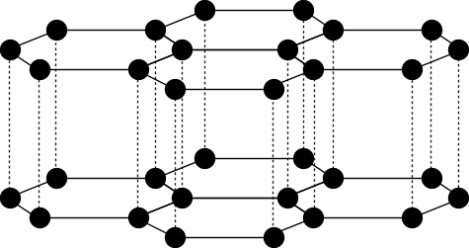
More on carbon: graphite
Very high melting point
Many covalent bonds must be broken to separate the atoms
Soft
Each C atom is joined to three others in a layered structure. Layers are held by weak Van der Waal’s forces and can slide over each other.
Conductor of electricity
Three C electrons are used for bonding, the fourth can move freely between the layers
Layers can slide over each other.
Used as a lubricant and in pencils.

Slide 17
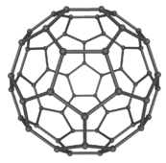

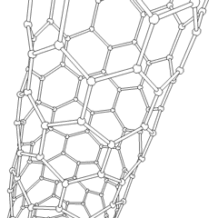
More on carbon: Buckminsterfullerene
Also called fullerene or “buckyball”, named after Richard Buckminster Fuller, whose geodesic domes the molecules looks like. Discovered in 1985. There are larger ones, e.g. C₇₀, C₈₄, C₁₀₀
C₆₀: The original (and smallest) fullerene.
It can be found in soot.
Its structure is the same as that of a football – pentagons and hexagons.
Carbon nanotubes: extensions of buckyballs.

Slide 18
Metallic Bonding

Slide 19
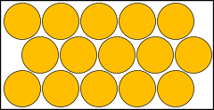
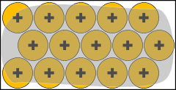
4. Metallic bonding
“The electrostatic attraction between a lattice of positive ions surrounded by delocalised electrons”
Metal atoms achieve stability by “off-loading” electrons to attain the electronic structure of the nearest noble gas.
This results in a lattice of positive ions and a “sea” of delocalised electrons. These electrons float about and are not associated to a particular atom.

Slide 20
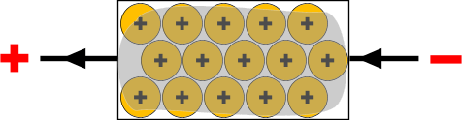
4. Metallic bonding: electrical conductivity
Because the electron cloud is mobile, electrons are free to move throughout its structure.
When the metal is part of a circuit, electrons leaving create a positive end and electrons entering create a negative end. These new arrivals join the “sea” already present.

Slide 21

4. Metallic bonding: malleability
Metals are malleable: they can be hammered into shapes.
The delocalised electrons allow metal atoms to slide past one another without being subjected to strong repulsive forces that would cause other materials to shatter.
This allows some metals to be extremely workable. For example, gold is so malleable that it can make translucent sheets.

Slide 22
4. Metallic bonding: melting points
The melting point is a measure of how easy it is to separate the individual particles. In metals it is a measure of how strong the electron cloud holds the positive ions.
 | Na (2,8,1) | Mg (2,8,2) | Al (2,8,3)
Melting point | 89°C | 650°C | 659°C
Boiling point | 890°C | 1110°C | 2470°C
<
<
Na⁺
Mg²⁺
Al³⁺
Increasing electron cloud density as more
electrons are donated per atom.
This means the ions are held more strongly

